Slide 1
Hardware Descriptive Languages these notes are taken from Mano’s book
It can represent:
Truth Table
Boolean Expression
Diagrams of gates and complex functions
Signals
Gates, and complex functions
A Complete Digital System

Slide 2
HDL, Area of Application
Design Entry
Logic Simulation
Functional Verification
Digital Circuit Synthesis
Timing Verification
Fault Simulation
Documntation

Slide 3
Declarations
Language Manual describes Syntax
Reserved words….around 100
Reserved words are lower case:
module, endmodule, input, output, wire, timescale…..
// is used for comments
/*….*/ Is used for multi-line comments
Blank spaces are ignored
Blank spaces may not appear within a reserved word, identifier, an operator or a number

Slide 4
Declarations
Verilog is case sensitive
module .. Must be closed with endmodule and there is no “;” after endmodule.
Combinational Logic can be described by:
Boolean Equations ,
Truth Table,
Schematic Capture
A digital System can be modeled in structural, algorithmic or behavioural.

Slide 5
Identifiers
Are case sensitive,
Must NOT start with numeric characters
They may contain the underscore “ _”
Example:
Asim
Al_Khalili
Al-khalili
COEN212

Slide 6
Verilog Constructs
Each module starts with reserved word module and ends with endmodule.
The port list is enclosed within parenthesis. Commas are used to separate the elements.
All statements must end with a “;”.
input and out define the ports.
wire defines the internal connections.
Gates are defined with reserved words and, not or …
Each gate is called by a gate instantiation. Gates names are optional but help in identifying the circuit.
Gate output, inputs are ordered separated with a comma and enclosed by parenthesis.

Slide 7
Example (Mano’s book 4thEdition)
A
B G1 w1
G3 D
C G2 E
// Verilog model circuit of above figure. IEEE 1364-1995 Syntax
module Simple_Circuit (A,B,C,D,E);
output D,E;
input A,B,C;
wire w1;
and G1 (w1,A,B);
not G2 (E,C);
or G3 (D,w1,E);
endmodule

Slide 8
Delays
The propagation delay is specified in terms of time units and is specified by the symbol #
and #(10) G1 (w1, A,B)
The association of time unit and the time scale is made with the compiler directive
‘timescale
The directive is specified before the declaration of a module
‘timescale 1 ns/100ps indicates unit of measurement for time delay followed by the precision round off.

Slide 9
Test Bench
T_Simple_Circuit
Test generator Circuit
reg wire
Stimulator
Circuit
// Test bench for Simple_Circuit__delay
module t_Simple_Circuit_delay;
wire D,E; // circuit output of the circuit to be tsted within the test bench
reg A,B,C; // output from stimulator and input to the circuit
Simple_Circuit_delay M1 (A,B,C,D,E); //instantiation of M1
Initial // statement to describe the testing waveform
begin
A= 1’b0; B=1’b0; C=1’b0; // one binary digit with a value of 0 for A,B and C
#100 A=1’b1; B=1’b1; C=1”b1; // after 100 ns inputs are changed to ABC 111
end
Initial #200 $finish; // end of the test application, ie. entire test simulation time
endmodule

Slide 10
Example
(Mano’s book 4thEdition)
A (30ns) w1 (20 ns)
B G1 G3 D
E
C G2 (10) ns
// Verilog model circuit of above figure. IEEE 1364-1995 Syntax
module Simple_Circuit_with_delay (A,B,C,D,E);
output D,E;
input A,B,C;
wire w1;
and #(30) G1 (w1,A,B);
not #(10) G2 (E,C);
or #(20)G3 (D,w1,E);
endmodule
Time units (ns) | Input A B C | Output E w1 D
 | 0 0 0 | 1 0 1 | Initial
 | 1 1 1 | 1 0 1 | initial
10 | 1 1 1 | 0 01
20 | 1 1 1 | 0 0 1
30 | 1 1 1 | 0 1 0
40 | 1 1 1 | 0 1 0
50 | 1 1 1 | 0 1 1

Slide 11
Example (Mano’s book 4thEdition)
A 30 ns w1 20 ns
B G1 G3 D
C 10 ns E
G2
A
B
C
W1
E
D
100 110 130 150

Slide 12
Boolean Expressions
Use reserved word assign and
&, | and ~ for AND,OR,NOT
Example:
// Boolean Circuit representation
module Boolean Circuit (E,F,A,B,C,D);
output E,F;
input A,B,C,D;
assign E= A| (B&C)|(~B&D); // A + (B.C) + (B’.D)
assign F= (~B &C) | (B& ~C & ~D); // (B’.C) + (B.C’.D’)
endmodule

Slide 13
User Defined Primitives
System primitives: and, or, nand, xor
One way is to define own primitive by a Truth Table….
Use primitive and endprimitive to create a UDP
It is declared with the reserved word primitive followed by a name and port list
One output and it must be listed first in the port listing and following the output declaration
Any number of inputs, however the order given in the port declaration must be the same as the Table
The table must start with the reserved word table and end with endtable
The values of the inputs are listed in order and separated from output by : the line ends with ;

Slide 14
User Defined Primitives
Example:
// Verilog model: User Defined Primitive
primitive UDP_02467 (D,A,B,C);
output D;
input A,B,C;
// Truth Table for D= f( A, B ,C ) = Σ m(0,2,4,6,7);
table
// A B C : D // headers
endtable
endprimitive
0 | 0 | 0 | : | 1;
0 | 0 | 1 | : | 0;
0 | 1 | 0 | : | 1;
0 | 1 | 1 | : | 0;
1 | 0 | 0 | : | 1;
1 | 0 | 1 | : | 0;
1 | 1 | 0 | : | 1;
1 | 1 | 1 | : | 1;

Slide 15
Calling of UDP
// Verilog model: Circuit instantiation of Circuit_UPD_02467
module Circuit_with UDP_02467 (e,f,a,b,c,d);
output e,f;
input a,b,c,d;
UDP_02467 (e,a,b,c);
and (f,e,d);
endmodule
a
b
c
d
UDP_02467
e
f

Slide 16
VHDL EXAMPLE
-- Interface ………… 1
entity XOR_2 is ……………… 2
Port ……………… .3
(A,B : in BIT; Z : out BIT); …………… 4
end XOR_2; ……………… 5
-- Body ………… …6
architecture DATA_FLOW of XOR_2 is …7
signal Sig 1, Sig 2: BIT; ……… 8
begin ………………9
Sig 1 <= A and not B; …………… ..10
Sig 2 <= B and not A; ………………11
Z <=Sig1 or Sig 2; ……………12
end DATA_FLOW; ……………13
Reserved word
Signal
Declaration
Concurrent assignment statement

Slide 17
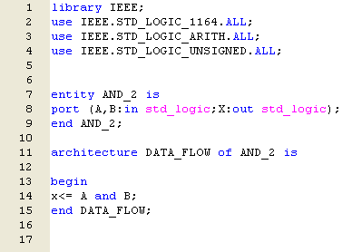

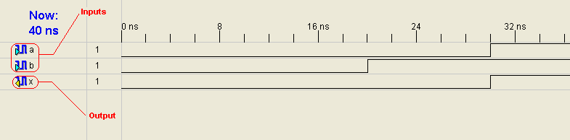
AND Gate simulation (VHDL)

Slide 18
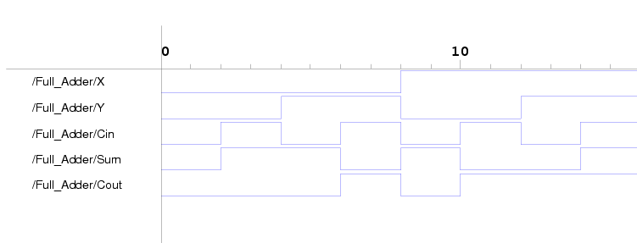
VHDL Full Adder Example
library ieee;
use ieee.std_logic_1164.all;
entity Full_Adder is
-- generic (TS : TIME := 0.11 ns; TC : TIME := 0.1 ns);
port (X, Y, Cin: in std_logic; Cout, Sum: out std_logic);
end Full_Adder;
architecture Concurrent of Full_Adder is
begin
Sum <= X xor Y xor Cin after 0.11 ns ;
Cout <= (X and Y) or (X and Cin) or (Y and Cin) after 0.11 ns;
end Concurrent;

Slide 19
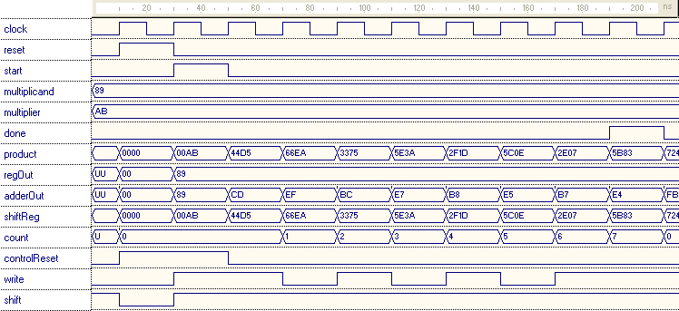
Example : VHDL Multiplier, Simulation Results
Multiplicand = 10001001₂ = 89₁₆
Multiplier = 10101011₂ = AB₁₆
Expected Result = 101101110000011₂ =5B83₁₆

