Slide 1
Optimizing Power and Performance in 28-nm FPGA Designs
Technology Roadshow 2011
1.0
Notes:
Welcome to the Altera Asia Pacific Technology Roadshow 2011

Slide 2
Agenda
Introduction
Power consumption in FPGAs
Power-saving features in 28-nm FPGAs
Altera power estimation tools
Designing for low power recommendations
Summary

Slide 3
Power Consumption in FPGAs

Slide 4
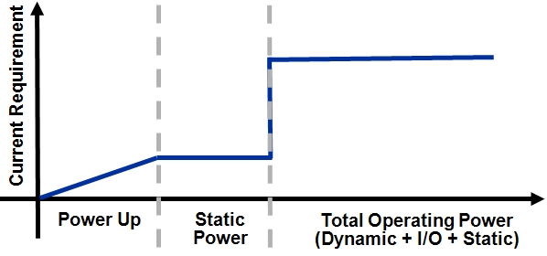

Power Requirement Basics in FPGAs
  High current spike during power-up due to charging of capacitive components on device
Power consumed by FPGA when no signals are toggling
  Mainly leakage current
Depends on selected device, junction temperature, and power characteristics (typical or maximum power)
  Rule of thumb:
  maximum power = 2X typical power
1
2
  NMOS and PMOS transistors ON causing higher current
  Mitigated by adjusting transistor biases, sizes, and threshold voltages
Modern FPGAs rarely exhibit this phenomena
Additional power consumed during operation of the device
Caused by signal toggling and capacitance load charging and discharging
Proportional to load capacitance, supply voltage (squared), and clock frequency
3
3
1
2
Notes:
Goal of this slide - Lay the foundations of power consumption. Engineers will understand all of the three types of power listed, but this introductory slide ensures you are all on the same page.
In-Rush (AKA Powerup Icc, surge Icc, startup Icc. Icc means current) is the current drawn by the FPGA immediately after power is applied to the pins. Typically, FPGAs would suck a lot of current during this stage, but technological innovation implemented in Stratix devices has allowed us to mitigate these effects
Static (AKA Standby, Quiescent, leakage) is the current drawn by the non-operating portions of the device. In this diagram, the static section shows the power consumption of the device in a non-operational condition (i.e.. no clock signal is applied).
Dynamic+Static (AKA Total Power) is the power consumed by the FPGA during normal operation of the device. The clock is oscillating & the customer’s design is operating. Actual dynamic power consumption (and therefore total power) will vary greatly from design to design based on frequency, resource utilization, operating temperature, & other factors.

Slide 5
Power-Saving Features in 28-nm FPGAs

Slide 6
What to Expect from Stratix V FPGAs
High-bandwidth technology leadership
  Hybrid FPGA with Embedded HardCopy Block
  40G/100G, PCI Express® (PCIe) Gen3 x8 and Interlaken hard intellectual property (IP)
  28G transceivers
  Variable-precision digital signal processing (DSP) block
50% higher system performance
30% lower total power
  Additional power savings possible from hard IP
50% lower physical medium attachment (PMA) power per channel
Programmable Power Technology
Easy-to-use partial reconfiguration
Bandwidth
Power
Notes:
The first question I would like to address is the following: What to expect from Stratix V FPGAs?
In a nutshell, Stratix V FPGAs are designed from the ground up to deliver the highest bandwidth at the lowest total power. At every design level, Altera made decisions to ensure Stratix V FPGAs are well positioned to meet the bandwidth/power goal. With Stratix V FPGAs, you can achieve 50% higher system performance compared to previous FPGA generations (Stratix IV) at 30% lower total power and 50% lower PMA power per transceiver channel. Additional power savings can be achieved by hardening logic in Stratix V FPGAs. In addition, by leveraging the easy-to-Use Partial Reconfiguration, customers can further reduce power and cost by using smaller density FPGAs.

Slide 7
Key Stratix V FPGA Technologies to Reduce Power
Level | Innovations Driving Lower Power and Higher Bandwidth
Process | 28-nm High-Performance (28HP) process innovations
FPGA Architecture | Programmable Power Technology
 | Lower voltage architecture (0.85 V)
 | High-bandwidth, power-efficient transceivers
 | Extensive hardening of IP and Embedded HardCopy Blocks
 | Hard power down of functional blocks
 | I/O innovations enabling power-efficient memory interfaces
Software | Quartus II software power optimization
 | Logic and RAM clock gating
System | Fewer power regulators: switching regulators on all supplies
 | Board-level integration: oscillators, decoupling capacitor, on-chip termination
 | Easy-to-use partial reconfiguration
Stratix V FPGAs Targeted as Lowest Total Power,
Highest Performance FPGAs in the Industry
Notes:
These are the various techniques and innovations that Altera leverages at various levels to reduce power while maintaining high performance. We’ll cover many of these techniques on the next few slides…
One thing to note is the 4 levels at which power optimization is done from process level up to the system/board level.

Slide 8
Key Arria V and Cyclone V FPGA Technologies to Reduce Power
Level | Innovations Driving Lower Power and Higher Bandwidth
Process | 28-nm Low-Power (28LP) process: low static power, low device capacitance
FPGA Architecture | Power-optimized architecture
 | Extensive hardening of IP: hard memory controller, PCIe, physical coding sublayer (PCS)
 | Lowest power transceivers for targeted data rates
 | Hard power down of functional blocks
Software | Quartus II software power optimization
 | Logic and RAM clock gating
System | Fewer power regulators: switching regulators on all supplies
 | Board-level integration: oscillators, decoupling capacitor, on-chip termination
 | Easy-to-use partial reconfiguration
Arria V and Cyclone V FPGAs Deliver the Lowest Total Power for Their Targeted Applications
Notes:
These are the various techniques and innovations that Altera leverages at various levels to reduce power while maintaining high performance. We’ll cover many of these techniques on the next few slides…
One thing to note is the 4 levels at which power optimization is done from process level up to the system/board level.

Slide 9
Altera’s Customization of 28HP Process
Stratix V FPGAs built on TSMC’s 28HP high-K metal gate (HKMG) process
  Optimized for low power
Ideal choice for high-end FPGAs used in high-bandwidth systems
  Delivers 35% higher performance than alternative process options
  Enables fastest and most power-efficient transceivers
Process Techniques on 28HP | Lower Power | Higher Performance
Custom low-leakage transistors* | 
Custom low bulk leakage * | 
Longer channel length transistors | 
HKMG |  | 
SiGe strain (PMOS) |  | 
Si₃N₄ strain (NMOS) |  | 
Lower capacitance |  | 
Lower voltage (0.85 V) | 
* Developed and exclusively used by Altera
Altera Customized HP Process Delivers Up to 25% Lower Static Power
Notes:
Stratix V FPGAs are manufactured on TSMC’s 28-nm HP process.
Altera worked closely with TSMC to customize the HP process to lower power while still taking advantage of the high performance delivered by this process.
Compared to other TSMC’s 28-nm options, the HP process delivers 35% higher performance. This is the ideal process for high-bandwidth FPGAs requiring fast core performance and fast periphery performance such as 28G transceivers.
This table lists the various knobs that Altera leverages to bring down power on the 28-nm HP process. In particular, the custom low-leakage transistors and the custom low-bulk leakage in transistors are exclusively used by Altera. This process customization delivers 25% lower static power compared to the standard 28HP process from TSMC.

Slide 10


Static Power Leadership: 28LP Process
Competitive
28nm FPGAs
Static Power (Watts)
< 800mW
for 500KLE
500 mW for 300KLE
Logic Density (KLE)
Conditions: 85C Junction, Typical Silicon
28LP Process Delivers the Lowest Static Power
Notes:
Presenters notes:
The lines shown here are trendlines that reflect the information available to us about static power consumption of all devices shown. Note that the trendlines include a small amount of error; for example, the static power for the 415KLE Kintex device is higher than the trendline indicates.
Customers can verify the trendlines using XPE 13.1 and the Preliminary Arria V EPE, which currently only shows the B1 and B3, but their static power will be along the Arria V trendline shown here. Note that the user agreements for the EPE/XPE stipulate that these tools may NOT be used for competitive comparisons, so be careful in explaining this.
Our static power claim that competitive 28nm FPGAs consume up to 2x the static power of Altera 28LP FPGAs is based on the static power of the Kintex 485KLE device (XC7K480T), which consumes 1.6W of static power (85C junction, typical silicon) vs. the Arria V 500 KLE device (5AGXB7) which consumes 0.8W of static power (85C junction, typical silicon).
Another thing to note is that the static power of the 300KLE Cyclone V device appears to be half the static power of the 28nm competitive FPGA based on the trendlines. The actual power estimates show that the Kintex 320KLE device has twice the static power of the 300KLE Cyclone V device.

Slide 11


Programmable Power Technology
Lowers total power consumption
  Automatically programmed via Quartus II software
Delivers performance where you need it
  Minimizes static power everywhere else
Technology exclusively used by Altera
Gnd
High Speed
Logic Array
Gate
Source
Channel
Drain
Power
Substrate
Low Power
High-Speed Logic
Low-Power Logic
Threshold Voltage
Lowers Static Power with No Impact on Design Performance
Notes:
One of the biggest technological leaps to control power on FPGAs is the use of Programmable Power Technology. This technology is a key differentiator for Stratix III, Stratix IV, and Stratix V FPGAs compared to competing devices.
Programmable Power Technology delivers the ability to lower static power consumption without impacting the performance of the design.
Quartus II design software automatically programs the speed of the transistors to put them in low-power mode or high-performance mode, depending on your design requirements. This is achieved by varying the substrate voltage of the transistor, which affects the threshold voltage and, in turn, affects the power/performance characteristics of the transistor.
As a result, the enhanced power/performance programmability allows you to get the exact performance and power consumption you need. It puts the performance where you need it, and minimizes the power everywhere else.
Our customers benefited greatly from reduced static power on Stratix III and Stratix IV FPGAs, so we’ve incorporated Programmable Power Technology on Stratix V FPGAs.

Slide 12
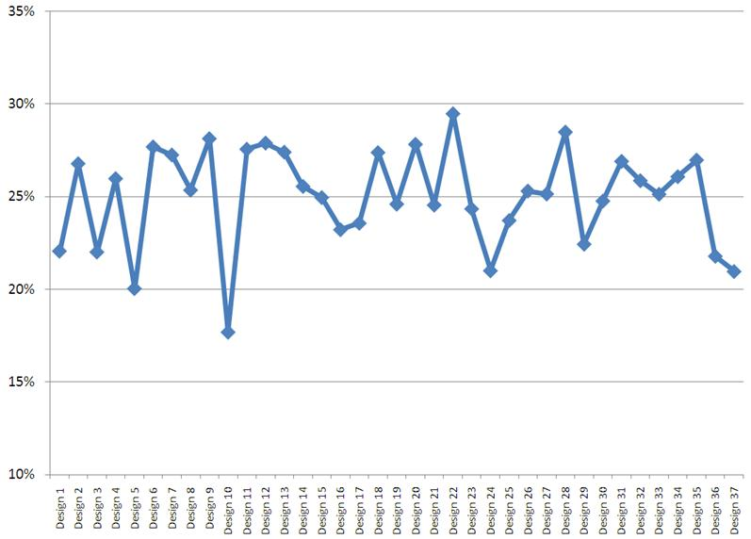
Power Savings Using Programmable Power Technology
Static Power Reduction (%)
25% Lower Static Power Without Impacting Performance
Notes:
Now you might be wondering, “How much power savings can I expect to achieve from Programmable Power Technology?” To best answer this question, we need to compare the static power when Programmable Power Technology is ON vs. when Programmable Power Technology is OFF.
We compiled 37 customer design-based patterns in Quartus II software twice: In the first compilation, Programmable Power Technology was turned off and we estimated the static power. In the second compilation, Programmable Power Technology was turned on, and Quartus II software identified the logic required to be in high-performance mode and set it accordingly. As for the rest of the logic, Quartus II software set those areas in low–power mode. As a result, we saw a 25% average reduction in static power across these designs with Programmable Power Technology.

Slide 13
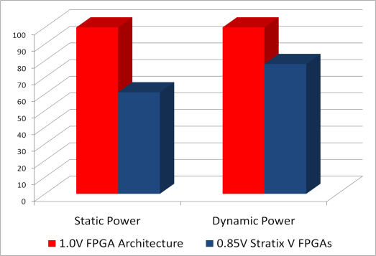

Stratix V FPGA Low-Voltage (0.85 V) Architecture
Lower static power
  Proportional to Vcc³
Lower dynamic power
  Proportional to Vcc²
-28%
-39%
Normalized Power
Note: Comparison of the same architecture on the same process
Lower Voltage Enables Significantly Lower Power
Notes:
Stratix V FPGAs are designed to operate at 0.85-V core voltage. Lower voltage implies that the FPGAs will be able to deliver significantly lower static power as well as lower dynamic power.
Static power is proportional to Vcc cubed while dynamic power is proportional to Vcc squared. With a lower voltage, Stratix V FPGAs deliver 39% lower static power and 28% lower dynamic power compared to another FPGA operating at 1.0V with the same architecture and on the same process.

Slide 14
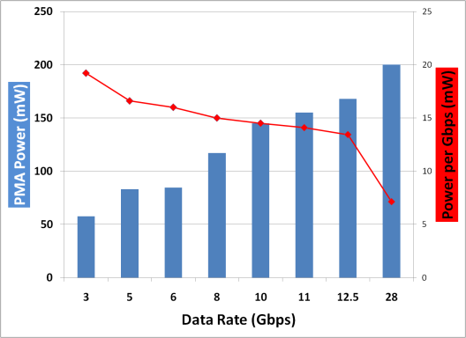
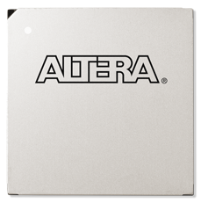

Stratix V FPGA Power-Efficient Transceivers
50% lower power per channel through:
  LC-PLL technology
  Lower operating voltage
  Clock gating
  Transistor body biasing
Higher power savings at higher data rates
200 mW/ch
at 28G
(7mW/Gbps)
4 XAUI Channels,
Each at 3.125 Gbps
1 Channel
10G
10G
240 mW
145 mW (-40%)
Highest Bandwidth and Power Efficiency
Notes:
Stratix V FPGAs offer twice the bandwidth compared to previous FPGA generations at lower power. The 28G transceiver consumes around 200 mW and allows the lowest power per Gigabit with only 7mW/Gb.
Altera leveraged various design techniques to ensure Stratix V transceivers are very power-efficient. These techniques include a low-power circuit design, the use of ultra-low jitter LC-PLL technology supporting low power at the highest data rates, and lower operating voltage.
It’s worth noting that by going to higher rates, you can achieve more power savings. For example, to build a 10G interface, you could use 4 XAUI channels, each running at 3.125 Gbps and consuming a total of 240mW or you could use just one 10G channel at 145mW and achieve 40% lower power.

Slide 15
Arria V FPGA Transceiver Power Comparison
Power per Channel
(Total PMA) in mW
Conditions:
85°C Junction
Typical Case
Arria V FPGA Transceiver Power is ½ to ⅓ that
of Other 28-nm FPGAs
Notes:
.

Slide 16
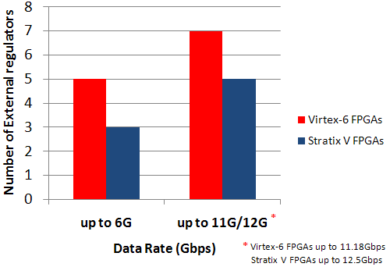
Stratix V FPGA Board-Level Design
Fewer power regulators
  Switching regulators allowed
  on all power rails
Dynamic on-chip termination
  Series and parallel termination
  Saves power and improves signal integrity
On-die and on-package decoupling
  Reduce capacitance on board
On-chip fractional PLLs (fPLLs)
  Integrate voltage-controlled oscillator (VCXO) and XO functionality
Lower Power, Lower Cost, and Easier Board Design
Notes:
Let’s now cover the various system and board level innovations that address power and bandwidth challenges.
To start off, Stratix V FPGAs require fewer power regulators across data rates compared to previous FPGA generations: Just 3 regulators for designs operating at 6.5 Gbps or lower and just 5 power regulators for designs running up to 12.5 Gbps. In addition, switching regulators are allowed on all power rails for maximum power efficiency.
Furthermore, Stratix V FPGAs feature dynamic on-chip termination, and both series and parallel termination, enabling significant I/O power savings and improving signal integrity. Moreover, Stratix V FPGAs have on-die and on-package capacitance delivering optimal signal integrity while reducing system cost. In addition, users can now integrate VCXO and crystal oscillator functionality in Stratix V FPGAs through the use of on-chip fractional PLLs. Overall, designing with Stratix V FPGAs enables lower power, lower cost, and easier board design.

Slide 17
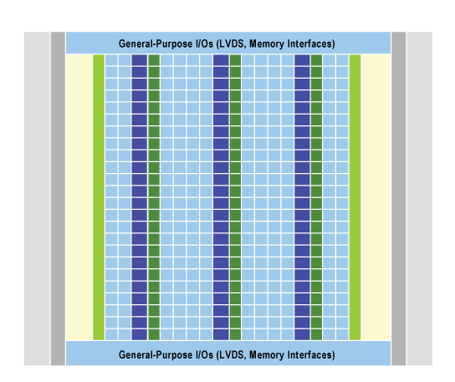
Stratix V FPGA Hard IP Blocks
Low-Power High-Speed Transceivers
Embedded HardCopy Blocks Provide Additional ~14M ASIC Gates or ~1.19M logic elements (LEs)
Hard IP per Transceiver:
3G/6G/10GbE PCS,
Interlaken PCS
PCIe Gen3/2/1 Hard IP
New fPLLs Integrate VCXO and XO
New M20K
Memory Block
New Variable-Precision DSP Blocks
Unprecedented Level of System Integration
Enabling Lower Power and Higher Bandwidth Designs
Notes:
Stratix V FPGAs deliver an unprecedented level of system integration through extensive hardening of various IP. This slide shows you the various hard IP functions available in Stratix V FPGAs.
Embedded HardCopy Blocks are new in Stratix V FPGAs. Embedded HardCopy Blocks harden standard or logic-intensive functions such as application-specific functions, transceiver protocols, and proprietary customer IP functions. The Embedded HardCopy Blocks enable faster time to market, higher bandwidth and performance, and lower cost and power. Altera has used Embedded HardCopy Blocks to develop PCI Express Gen3 Hard IP and 40GE/100GE PCS hard IP.
In addition, each transceiver in Stratix V FPGAs has a hard PCS for multiple protocols including Interlaken, 10G Ethernet, Serial RapidIO, and CPRI or OBSAI. You can also build your own custom PCS using the various PCS hard IP blocks.
Furthermore, a new fractional PLL in Stratix V FPGAs enables you to integrate VCXO functionality and crystal oscillators on-chip and reduce board design cost.
A new M20K memory block and a new variable-precision DSP block are also available in Stratix V FPGAs—both of these blocks enabling higher bandwidth and lower power.
Overall, with Stratix V FPGAs, you can expect to achieve much higher system integration to lower power and cost and reach higher bandwidth levels.

Slide 18
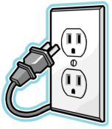
Power Down of Functional Blocks
Modular design enables power down of unused blocks
 | Cyclone V FPGAs | Arria V FPGAs | Stratix V FPGAs
Transceivers (PMA + PCS) |  |  | 
I/O banks |  |  | 
M20K or M10K memory blocks |  |  | 
fPLLs |  |  | 
Embedded HardCopy Blocks | NA |  | 
Hard memory controller |  |  | NA
When
Unused
Automatic Power Down of Unused Functional
Blocks by Quartus II Software
Notes:
Another architectural improvement in Stratix V FPGAs is the capability to power down unused functional blocks to significantly save power.
These blocks include transceiver PMA and PCS blocks, Embedded HardCopy Blocks, I/O banks, internal memory blocks, and fractional PLLs.
Quartus II design software automatically powers down any unused functional blocks, ensuring maximum power savings.

Slide 19
Easy-to-Use Partial Reconfiguration with 28-nm FPGAs
Ability to reconfigure part of the design while the other part is running
Suitable for designs with many permutations not operating simultaneously
Enables significant power savings through the use of smaller FPGA
A1
B1
A2
B2
FPGA
Smaller FPGA Using
Partial Reconfiguration
A2
B2
A1
B1
Smaller FPGA
Higher Flexibility and Lower Power
Notes:
19
19
Stratix V FPGAs deliver partial reconfiguration capability to users to allow them to reconfigure part of the FPGA design while other sections remain running. This is extremely important in systems where uptime is critical because it allows you to make updates or adjust functionality without disrupting services. It also allows you to program the FPGA with only the active functions, reducing the need for a higher density part and dramatically reducing cost and power.
Altera provides an easy-to-use design flow which is enabled by leveraging the proven LogicLock and incremental compilation flow in Quartus II software.
Partial reconfiguration has historically been difficult because it requires a strong software tool to make it usable by customers. Quartus II software brings the strength of usability that is required to make easy-to-use partial reconfiguration a reality.
Reductions in cost and power consumption are achieved by enabling the use of smaller FPGAs for implementing functions of designs in a design reconfigurable partition. These are functions that do not need to be active at the same time, such as different protocol IP functions on multi-standard high-speed interfaces. This method can also be used to power down unused partitions, thus saving additional power.

Slide 20
Altera Power Estimation Tools

Slide 21
Power Analysis Tools
Higher
EPE Spreadsheet
Quartus II PowerPlay Power Analyzer
Simulation
Results
Placement and
Routing Results
Estimation Accuracy
Quartus II
Design Profile
User Input
Design Concept
Design Implementation
Lower
Project Timeline
Notes:
Altera delivers two power estimation tools: A spreadsheet based Early power estimator and a Quartus II Power Analyzer.
EPE is used early on in the project timeline.
Quartus II power estimation is usually done once the design is close to completion.
EPE delivers good reliable power estimation while Quartus II power analyzer delivers the highest power estimation accuracy.
The PowerPlay EPE is a spreadsheet-based analysis tool that enables early power scoping based on device and
package selection, operating conditions, and device utilization. The EPE has the industry’s most accurate models of
the functional components within the FPGA, but because the EPE is used before an RTL design is available, it lacks
critical information such as logic configuration, placement, and routing, limiting its overall accuracy. Nevertheless,
customers rely upon the EPE as their primary power estimation tool because it enables early design cycle estimates.
The PowerPlay power analyzer is a far more detailed power analysis tool that uses actual design placement and
routing and logic configuration, and can use simulated waveforms to estimate dynamic power very accurately. The
power analyzer, in aggregate, usually provides ±10 percent accuracy when used with accurate design information.

Slide 22
Power Analysis Tools
 | EPE | Power Analysis and Optimization (Quartus II Software)
When to use | Before or during design implementation | Near or upon design completion
Accuracy | Reliable estimation (+/- 15%) | High accuracy analysis (+/- 10%)
Dynamic power | Based on resource usage User-entered clock toggle rate | Based on resource usage Resource (RAM, PLL, DSP, etc) configuration and mode User-entered toggle rate or vector-based simulation
Static power | Exponential function of temperature May depend on resource usage
Where to find | http://www.altera.com/support/devices/estimator/pow-powerplay.html | Quartus II software
Notes:
Comparing the two tools: EPE and Power Analyzer.
Both tools are accurate with Quartus II power analyzer delivering more accuracy due to the fact that the design information is more accurate with more accurate toggle rates.
One thing to note: static power estimation is the same in both tools since it is mostly independent of resource usage.
Mention that the EPE is available on the web with a free download.

Slide 23
PowerPlay Solution to Power Closure
PowerPlay Power Technology Tools
Features | Benefits
EPE | Rich modeling environment Reliable estimate before design development Spreadsheet-based “what-if” analysis
PowerPlay power analyzer | Detailed design power analysis High accuracy Use actual design placement and route and logic configuration
Automated power optimization | Automatic power reduction Provide recommendations and suggestions to reduce power
Power Optimization Advisor
Fast System Closure,
Board Layout, and
System Development
Meet Power Budget at Every
Step of Design Flow
Increase Productivity
Notes:
Challenge:
Increasing FPGA densities and performance make power consumption considerations more important than ever
With larger devices implementing much more of your system functionality, the FPGA will consume more power.
Additional power consumption comes from the ability to implement more and more High Speed Applications in FPGAs.
Solution:
Need to estimate power early in design flow → Early Power estimator.
When the details of the design are available, users can enter the design in Quartus II software and get a more accurate power estimation.
Quartus II Power Analyzer provides 4 main features to maximize power reduction:
Simulation-based power estimation
Automated power optimization
Power advisor

Slide 24

Quartus II Software Power Optimization
Design
Entry
Constraints
Speed ☑
Area ☑
Power ☑
Set Compiler Settings to Focus on Reducing Power
Synthesis
Optimize Power ☑
PowerPlay
Power
Analyzer
Accurate power modeling
Physics-based models
Proven methodology and correlation
Accurate modeling enables good optimization
Routing, logic, RAM, and static
Placement and Route
Optimize Power ☑
Power-Optimized
Design ☑
Notes:
Let’s spend a little more time on Quartus II power optimization
One key area is in the ability of the Quartus II software synthesis and place and route engine to be power aware. This power reduction method is transparent to users and enabled through simple compilation settings. You simply set the timing constraints as part of the design entry process and synthesize the design to meet your performance requirements.
Quartus II software automatically selects the required performance for each piece of logic and also minimizes power through power-aware placement, routing, and clocking. The resulting design meets your requirements with the minimum power.
You also have the option to select low effort or high effort optimization. Selecting high effort offers the greatest power savings at the expense of longer compilation times. Results will vary based on your design and effort level selected. The goal of this feature is to reduce power without user intervention while minimizing the impact on design performance.
Another thing worth mentioning is that power optimization is guided by detailed models of the circuitry and by advanced statistical techniques that estimate which signals are toggling the most often – this allows us to determine power-efficient implementations without extra input from the user (such as a time-consuming simulation of the design to determine switching rates).

Slide 25
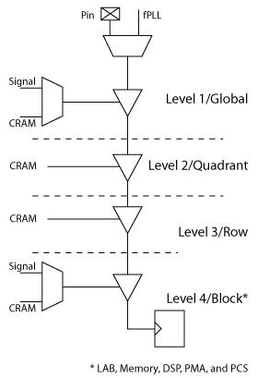
Clock Gating Power Optimization
Automatically done by Quartus II software to reduce dynamic power by preventing unused logic from toggling
  Enabled in Normal and Extra Effort power optimization
  Power savings can be up to 10% (design dependent)
Stratix V FPGA clock network can be gated at 4 levels:
  Global, quadrant, row, and block
Two modes of clock gating:
  Static: Set at compile time using configuration random access memory (CRAM) bit. Permanently enable or disable clock (levels 2 and 3)
  Dynamic: Controlled by user or Quartus II software during circuit operation (levels 1 and 4)
Additional clock gating can be constructed by users at design entry
  Highly dependent on circuit functionality
  See next slide for an example
Notes:
One integral part of the Stratix V FPGA’s architecture is the capability to gate clocks to reduce dynamic power by preventing unused logic from toggling. The clock network in Stratix V devices is designed to deliver the lowest skew for highest performance and with gating capability to reduce dynamic power.
The clock network in Stratix V FPGAs can be gated at four levels: At the top or global level close to the clock pins, in the center of each quadrant, at the row level in each quadrant, and at the block level. This segmentation of the clock network enables Quartus II design software to have more granular control of the clock network for more efficient dynamic power reduction.
Furthermore, the Quartus II placement algorithm automatically optimizes register placement so that fewer portions of the clock network need to be active to reach all the registers in a clock domain, minimizing power. All portions of the clock tree that aren’t needed to reach registers are shut off – that is permanently gated. Also, clock enables specified in the design or created by power-aware synthesis automatically gate the lower levels of the clock tree whenever the enable signal is low, saving additional power.
Static clock gating is automatically done by Quartus II software at compile time.
Dynamic clock gating can be controlled by user or by Quartus II software using a logic signal to enable or disable clock during circuit operation.
Question: Why doesn’t Altera enable dynamic clock gating at levels 2 and 3?
Answer: no significant power saving can be achieved through dynamic clock gating at levels 2 and 3 since the likelihood of a clock to be dynamically gated at these intermediate levels is very low.

Slide 26
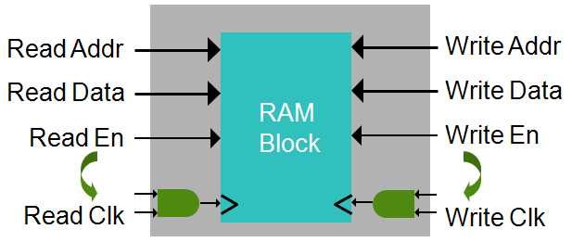
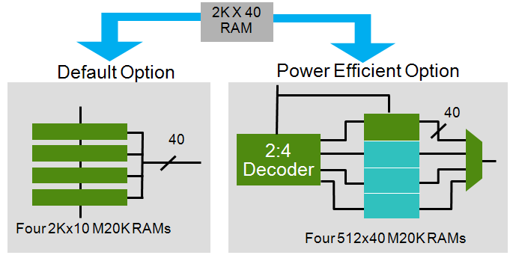
RAM Block Power Optimization
Convert RAM read and write enable to clock enable
  More clock gating reduces dynamic power
Power-efficient physical mapping of RAM blocks
  Same functionality for up to 75% less power
Significantly Lower RAM Power
Using Quartus II PowerPlay Power Optimization
Notes:
Another key power optimization technique in Quartus II design software is related to the power-efficient implementation of the embedded RAM blocks.
Here, Quartus II software instantiates additional clock enables using read and write enables of the memory to shut down RAM operation and save power. This optimization is done automatically by Quartus II software when either the normal or extra effort power optimization setting is selected.
A further RAM power optimization is performed automatically by Quartus II software when extra effort power optimization is selected. Large (wide and deep) RAM structures can be mapped to the physical block RAMs in a Stratix FPGA in several ways. Consider, for example, a RAM in your design that is to be 2K words deep by 40 bits wide.
The most straightforward method, shown on the figure at the left in the lower right corner of the slide, is to use four M20K RAMs each providing 2K words that are 10 bits wide. By accessing all four RAMs in parallel, a 40-bit wide word is accessed each cycle.
The implementation on the right, in the same figure, is more power-efficient. In this case, Quartus II software again uses four M20K RAM blocks, but each RAM block stores 512 40-bit wide words. Each cycle, a small amount of soft logic looks at the top two address bits to determine which RAM stores the desired word, and accesses the appropriate RAM. This greatly reduces RAM power, since 3 of the 4 RAM blocks can now be clock gated on each cycle.

Slide 27
Power Model Accuracy
Altera strives to deliver the most accurate power models to customers
EPE and Quartus II software share the same models for static and functional block power
With Quartus II software, users can achieve higher accuracy
  More accurate toggle rates and resource utilization
Phase | EPE | Quartus II Software
Pre-silicon | Preliminary models
Final power models | +/- 15% | +/- 10%
Note: Accuracy numbers shown in table assume good toggle rate estimates
Notes:
One key component to accurate power estimation is the power models used when estimating power.
Altera strives to deliver the most accurate power models to customers at every stage of the design.
Before silicon is correlated, Altera bases the power models on Hspice simulations. After silicon is received, Altera correlates the models to silicon and adjusts the models accordingly.
In general, Altera finalizes the power models within one year after silicon is received.
When models are finalized, power estimation is within 10% to 15% of silicon depending on which power estimation tool is used. With Quartus II software, users can achieve higher accuracy due to more accurate toggle rates and resource utilization.

Slide 28
Designing for Low Power: Recommendations
Notes:
Here are few recommendations and techniques to help you design for low power.

Slide 29
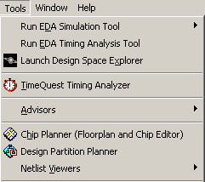

Partition Design For Maximum Power Optimization
Use “Design Partition Planner” in
Quartus II software to partition a design
  Auto-partition option helps in creating an
  initial partitioning scheme for use in
  incremental compilation
Optimize each partition for power or performance separately
  Achieve max mum power savings per partition where maximum performance is not required
  Achieve maximum performance where needed
Partition Top
A
Power ☑
Partition B
B
C
D
E
Partition F
F
Speed ☑
Power ☑
Notes:
The first recommendation is to use the Design partition planner to partition the design into multiple partitions, and then optimize each partition for power or performance. Users can partition the design based on the design functionality and timing constraints. Partitions with challenging timing constraints can be optimized for performance while the rest of the partitions can be optimized for power.
In addition to enabling lower power where possible, partitioning the design enables users to use Incremental Compile where they can make changes to a specific partition and quickly compile that partition without impacting the rest of the design, thus significantly reducing compile time.
Creating partitions prevents the software from performing logic optimizations across partition boundaries during synthesis or placement, which also allows incremental behavior by enabling each partition to be synthesized or placed and routed independently at any time.
Design iteration time is reduced by focusing the compilation effort on a particular partition, while partitions that do not change are not recompiled. Optimization techniques, such as physical synthesis, can also be targeted to specific design partitions while leaving other logic blocks untouched.
Using assignment editor, you can specify the optimization technique for each partition in the design to be either “speed” or “power”. You can also specify the power optimization settings for each partition to be either Normal or Extra Effort.

Slide 30
Design Narrower Electrical Interfaces
Leverage faster transceivers running at higher data rates
  Power efficiency increases with higher data rates
Reduce number of transceiver channels
Lower power per Gbps
Achieving 10G Bandwidth at 40% Lower Power
4 XAUI Channels,
Each at 3.125 Gbps
1 Channel
10G
10G
240 mW
145 mW (-40%)
Achieving 100G Bandwidth at 50% Lower Power
CFP
4 x 28G Transceivers
CFP2
10 x 11.3-Gbps
Transceivers
1.58 W
0.8 W (-50%)
Notes:
With high-bandwidth, low-power transceivers, users can design narrower electrical interfaces by using smaller number of lanes running at higher data rates. The power per Gbps goes down as the data rate goes up. You can reference slide 21 as a reminder.
Two examples are shown on this slide.
In the first example, a 10G interface is implemented using 4 XAUI lanes or 1 10G lane. You can see that the 1 lane implementation achieves the same bandwidth at 40% lower power.
In the second example, a 100G interface is implemented using 10 x11G lanes or by using 4x28G lanes. The narrower interface saves 50% power.

Slide 31
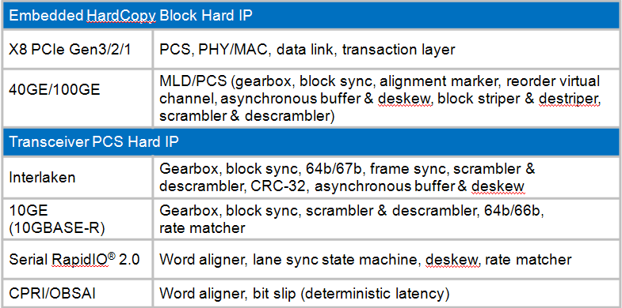
Use Hard IP when Available
65% lower power
2X higher performance and guaranteed timing closure
Lower cost by using smaller FPGA
Hard IP in Stratix V FPGAs
Examples of Logic Savings Using
Hard IP
 | Estimated Logic Utilization in LEs (K)
High-Speed Serial Protocol | Soft IP | Stratix V FPGAs
PCIe Gen3/2/1 | 130 | 0
Notes:
Another technique worth mentioning, even though it may seem obvious, is to try to leverage the extensive hard IP available in Stratix V FPGAs. By directing your RTL code to make use of the hard IP in Stratix V, the Synthesizer and the place&Route modules in Quartus II software will map your logic to hard IP whenever possible. By doing so, you can save extensive power while achieving much higher performance.
The table on the right shows the Logic utilization savings achieved for various Hard IP blocks in Stratix V FPGAs.
Note: For the 10GE, 40GE, 100GE, and Interlaken Hard IP in Stratix V FPGAs, only the PCS is currently hardened. Altera is considering hardening the MAC for these protocols. If customers are interested in a hard MAC in Stratix V FPGAs for these protocols, let Product Marketing know about these customers, and Marketing can follow up and get their feedback.

Slide 32
Leverage Partial Reconfiguration to Reduce Power
Save logic partitions off chip and use smaller FPGA
  Possible in designs with partitions that don’t run simultaneously
  Swap partitions when needed
Put “idle” partitions in low-power state
  Power down features in “idle” partitions
  M20K/M10K memory blocks, fPLLs, transceivers (PMA and PCS), I/O blocks, hard IP blocks (PCIe Gen3/2/1)
Notes:
One main benefit of Partial Reconfiguration is to reduce power in designs. This can be achieved in two ways:
Customers can partition their designs and save some logic partitions off chip (either in flash memory devices or in host), thus enabling the design to fit in a smaller FPGA → lower power consumption and lower cost. This is possible for designs which can be partitioned and the partitions do not run simultaneously. Customers can then swap partitions when needed.
The second way in which partial reconfiguration can be used to lower power is by putting “idle” partitions in low-power state. This can be done by partially reconfiguring partitions to power down features in these “idle” partitions such as memory blocks, PLLs, transceiver blocks, I/O blocks, and Hard IP.

Slide 33

Choose the Right Tile Usage Setting in EPE
Start with
“Typical Design” setting
Ideal for designs with easy-to-meet
timing constraints
If timing is hard to meet
Change to Typical High-Performance setting
Ideal for designs with hard-to-meet
timing constraints
If timing is challenging to meet
Change to Atypical High-Performance setting
Ideal for designs with challenging
timing constraints
Notes:
This slide can be skipped or quickly covered if you feel this concept is well understood by the audience based on the two slides 18 and 44.
As discussed previously (Slide 44), there are three High-Speed Tile Usage in the EPE:
Typical Design (0% HS tiles)
Typical High Performance (10% HS tiles)
Atypical High Performance (25% HS tiles)
This setting impacts static power consumption → Most designs require 10% of logic tiles to be in High-Speed.
A tile is defined as Two LABs, or One DSP block, or one M20K Block.
As a percentage of total power, the power savings from choosing different tile usage may not be significant. However, when the design is idle, this setting has a big impact on static power consumed while the design is idle (Slide 18).

Slide 34
Other Design Considerations (1/2 )
Reduce logic utilization by running at higher f_{MAX}
  Double f_{MAX} and cut logic utilization by half
Share resources within design
  Reduce number of functional blocks used in design (fPLL and clocks)
Lower operating junction temperature
  Static power increases exponentially with temperature
  Increase air flow and/or use larger heat sinks
Look for opportunities to gate logic when idle
  Significantly impact dynamic power
Notes:
Next we will cover other suggestions to consider when optimizing designs for low power.
(1) By running logic at higher frequencies, users can reduce logic utilization.
(2) By sharing resources in the design, you reduce the number of resources used and save power.
(3) By lowering junction temperature, you can significantly reduce static power since static power is exponentially proportional to Tj. You can lower Tj by increasing air flow and/or using larger heat sinks.
(4) You can try to prevent logic from toggling when it is not required. This requires RTL code change, and Quartus II software will synthesize and fit the design accordingly.

Slide 35
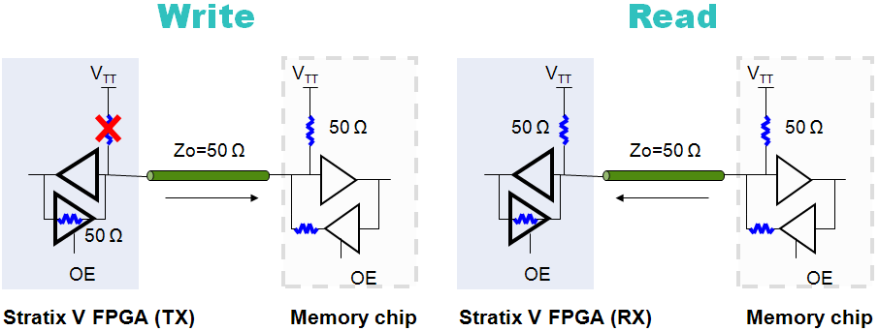
Other Design Considerations (2/2 )
Use dynamic on-chip termination for memory interfaces
  1.0-W savings on a 72-bit interface with a 50/50 read and write cycle
User lower drive strength in I/O buffer to get the job done
  Stratix V FPGA I/O block features programmable drive strength
  Lower drive strength → lower current → lower power
Notes:
By leveraging the dynamic on-chip termination for memory interfaces, users can save significant power in the I/O block. With Dynamic OCT, dynamic termination is turned off during write and enabled during read. Series termination is turned on during write and turned off during read.
Altera was the first company in the industry to introduce dynamic OCT (DOCT) on FPGAs to effectively reduce I/O power when interfacing an FPGA with external memory interfaces. As seen in this figure, DOCT turns on and off the RS OCT (series on-chip termination) and RT OCT (Parallel on-chip termination) dynamically during data transfer. During the write cycle, Series termination is turned on and parallel Termination is turned off to match the line impedance, while during the read cycle, Series Termination is turned off and Parallel termination is turned on as Stratix V FPGAs implement the far end termination of the bus. On a typical 72-bit DIMM, Stratix V FPGAs reduce I/O static power by up to 65% (1.9 W) at 1067 Mbps when compared to a standard FPGA using DDR2 without DOCT.
Another suggestion to lower power in the I/O block is to use lower drive strength in the I/O buffer to get the job done. With Stratix FPGAs, you can choose between different level of drive strength depending on the capacitance load being driven by the FPGA. The lower the drive strength, the smaller the required current, and thus the more power savings is achieved.

Slide 36
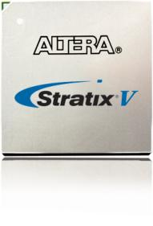
Summary
Altera 28-nm FPGAs are designed to deliver the lowest total power
Altera’s power estimation tools are very accurate and easy to use
Built for Bandwidth
at Lowest Total Power
Notes:
Finally, Stratix V FPGAs are designed to deliver the highest bandwidth at the lowest Total power in the industry. Altera strives to deliver accurate and easy-to-use power estimation tools including the EPE spreadsheet and the Power Analyzer in QII software.

Slide 37
Thank You
Optimizing Power and Performance in
28-nm FPGAs
Notes:
Thank you

